Slide 1
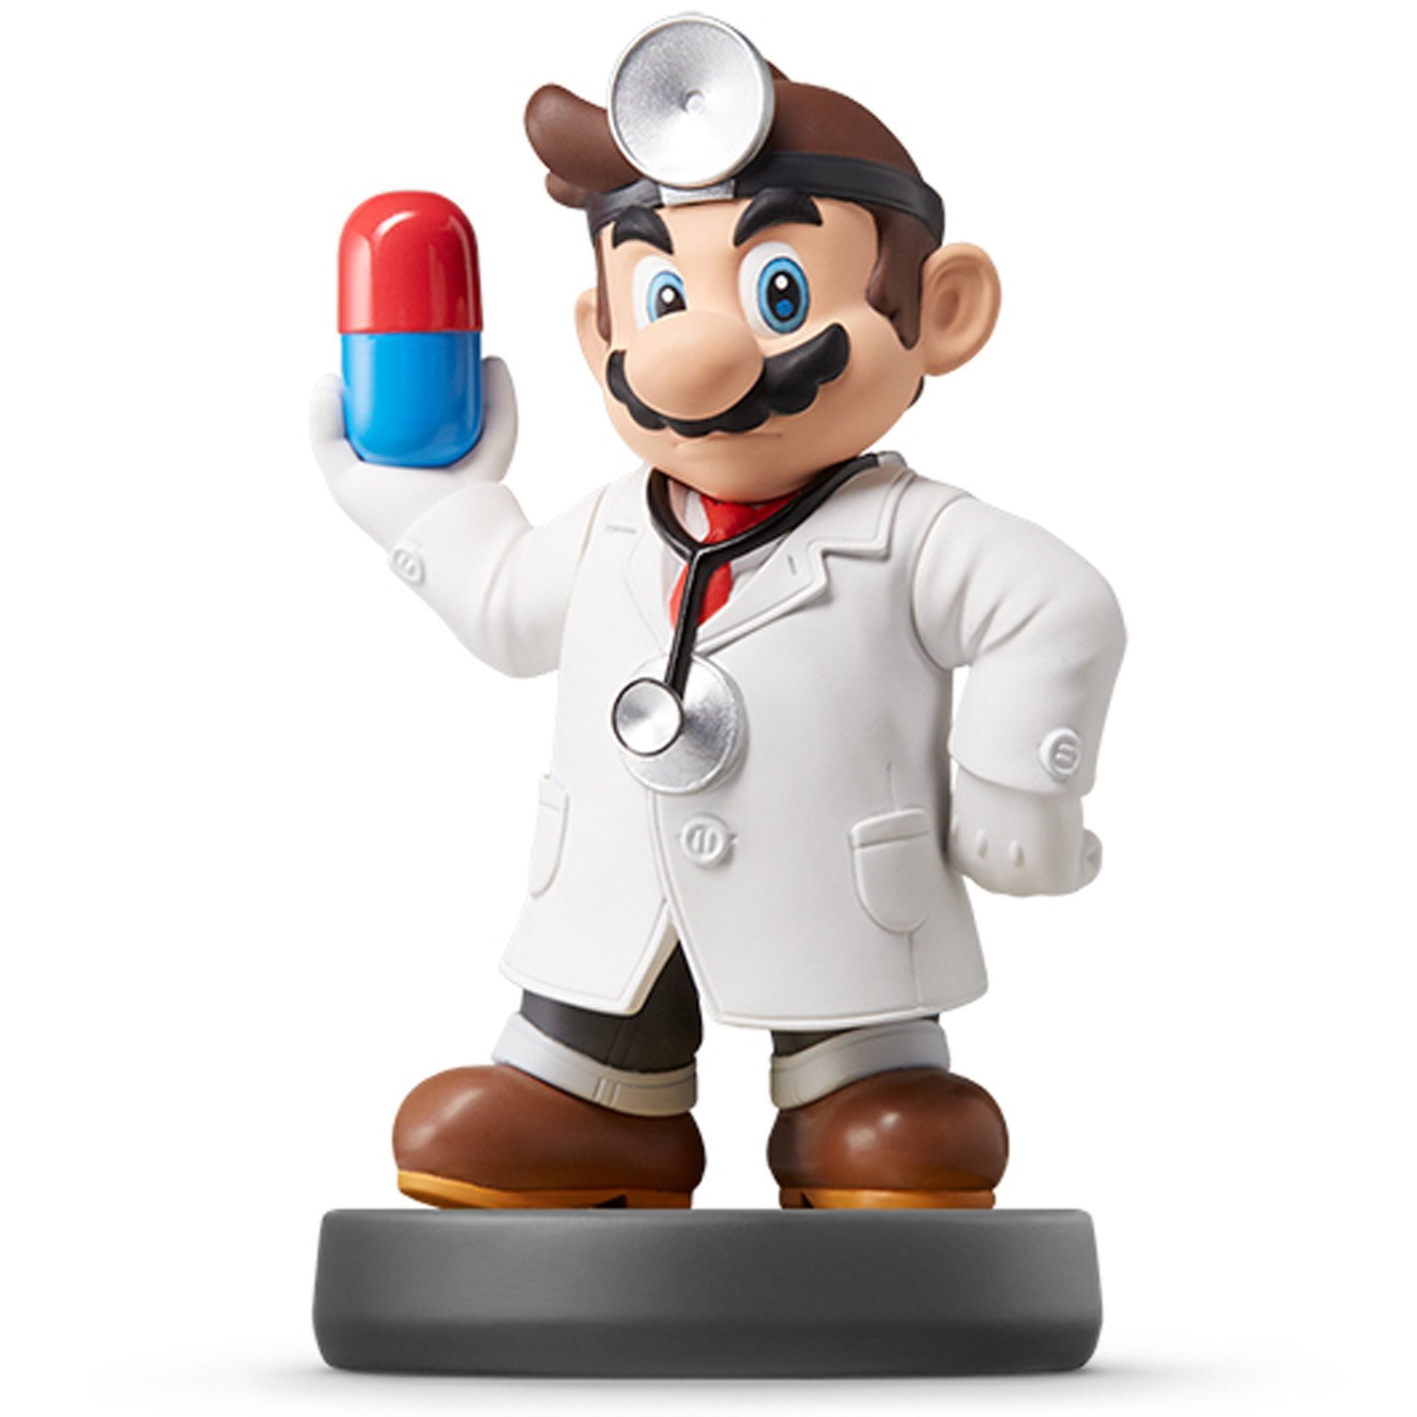
Data Visualization

Slide 2
Who are you?
Fill-out: Form

Slide 3
Closing?
Disperse and Make Reasonable Decisions

